Slide 1
UNIT IV – SDN Application and Use Case
UNIT I – SESSION 1
SESSION 5
SDN in Other Environments
Mobile Networks.
In-Line Network Functions
Optical Networks
Reference: Ref. 1, Ch.8.5, 8.6, 8.7

Slide 2
Mobile Networks
Mobile networking vendors, such as AT&T, Verizon, and Sprint, compete for customers to attach to their networks.
When mobile customers use traditional WiFi hotspots to connect to the Internet, those mobile vendors effectively lose control of their customers.
This is because the users’ traffic enters the Internet directly from the hotspot.
Since this completely circumvents the mobile vendor’s network, the vendor is not even aware of the volume of traffic that the user sends and receives and certainly cannot enforce any policy on that connection.
When customer traffic circumvents the mobile provider’s network, the provider loses a revenue-generating opportunity.
Thus, the mobile provider is interested in a solution that allows its customers to access its networks via public WiFi hotspots without the provider losing control of and visibility to its customers’ traffic. The owner of such hotspots may want for multiple vendors to share the WiFi resource offered by the hotspot.

Slide 3
SDN Applied to Mobile Networks
Mobile vendors interested in gaining access to users who are attaching to the Internet via WiFi hotspots require a mechanism to control their users’ traffic.
Control in this context may simply mean being able to measure how much traffic that user generates.
It may mean the application of some policy regarding QoS.
It may mean diverting the user traffic before it enters the public Internet and redirecting that traffic through its own network.

Slide 4
SDN Applied to Mobile Networks
SDN technology can play a role in such a scheme in the following ways:
• Captive portals - It requires allowing users to register for access based on their mobile credentials. Once valid credentials are processed, the user is granted appropriate levels of access.
• Tunneling back to the mobile network - establishment of tunnels from the user’s location back to the mobile vendor’s network. By programming SDN flows appropriately, that user’s traffic would be forwarded into a tunnel and diverted to the mobile vendor’s network.
• Application of policy - Usage charges could be applied by the mobile provider. In addition to charging for this traffic, other users pecific policies could be enforced. Such policies could be applied at WiFi hotspots where the user attaches to the network. SDN-enabled access points can receive policy, either from the controller of the mobile vendor or from a controller on the premises.

Slide 5
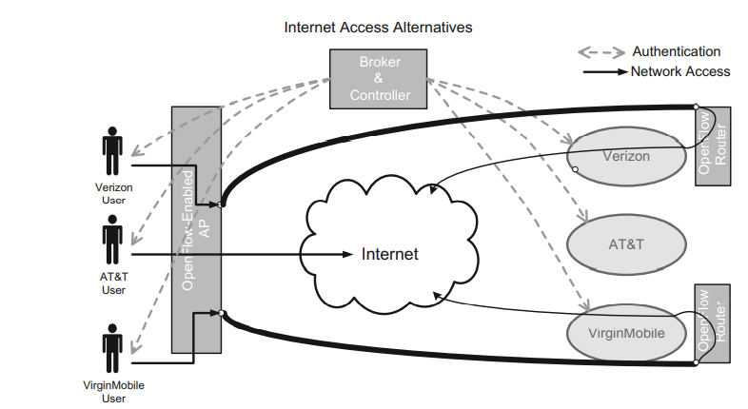
SDN and Openflow in Mobile Networks

Slide 6
SDN and Openflow in Mobile Networks
In Figure, the customers on the left want to access the Internet, and each set has a different carrier through which they gain network access.
Connecting through an OpenFlow-enabled wireless hotspot, they are directed through a broker that acts as an OpenFlow controller.
Based on their carrier, they are directed to the Internet in various ways, depending on the level of service and the mechanism set up by the carrier.
In the example, AT&T users gain access directly to the Internet, whereas Verizon and Virgin Mobile users access the Internet through being directed by OpenFlow through a tunnel to the carrier’s network.
Both tunnels start in the OpenFlow-enabled AP. One tunnel ends in an OpenFlow-enabled router belonging to Verizon, the other in an OpenFlow-enabled router belonging to Virgin Mobile.
These two routers then redirect their respective customers’ traffic back into the public Internet.

Slide 7
SDN and Openflow in Mobile Networks
In so doing, the customers gain the Internet access they desire, and two of the mobile providers achieve the WiFi offload they need while maintaining visibility and control over their users’ traffic.
To facilitate such a system, there is presumably a business relationship between the providers and the hotspot owner whereby the hotspot owner is compensated for allowing the three providers’ users to access the hotspot.
There would likely be a higher fee charged Verizon and Virgin Mobile for the service that allows them to retain control of their customers’ traffic

Slide 8
OpenFlow-based use cases.
ONF’s Wireless and Mobile Working Group has published a number of OpenFlow-based use cases.
Flexible and scalable packet core
Dynamic resource management for wireless backhaul
Mobile traffic management
Management of secured flows in LTE
Media-independent handover
Energy efficiency in mobile backhaul networks
Security and backhaul optimization
Unified equipment management and control
Network-based mobility management
SDN-based mobility management in LTE
Unified access network for enterprise and large campus

Slide 9
In-Line Network Functions
In-line network functions - functionality such as load balancers, firewalls, intrusion detection systems (IDS), and intrusion prevention systems (IPS).
These services must be able to inspect the packets passing through them.
These functions are often delivered in specialized appliances that can be very expensive. These appliances are bumps in the wire, meaning that they are inserted into the data plane. In some cases, the bump shunts traffic to an out-of-band processor, which can result in cost savings.
In other cases, the value-added service performed by the appliance is performed at line rate, and the increased cost of such devices is necessary if performance is of paramount concern.
Data centers and SPs that must employ these types of services welcome any novel means to drive down the costs associated with these devices.
A hybrid system can be implemented in the SDN paradigm by shunting only those packets requiring deeper inspection to an appliance that is off the data path.
This approach has the advantage of removing the bump in the wire, since packets that are not subject to deeper inspection suffer no additional latency at all.

Slide 10
In-Line Network Functions
Furthermore, since not all packets need to be processed by the appliance, fewer or less powerful appliances are needed in the network.
This can be realized in SDN by simply programming flow rules, which is much simpler than the special Switch Port ANalyzer (SPAN) ports that are in use on contemporary traditional switches.
SDN has been proposed to address network service needs through network functions virtualization (NFV).
The idea of NFV is to move service functionality (load balancers, firewalls, etc.) off specialized appliances and implement it as software that runs on common server platforms.
This has been made possible by advances in server and network interface technology.
Applications that once required specialized hardware for both CPU and NICs can now be performed by industry-standard servers.

Slide 11
Migrating to NFV
Migrating to NFV is not without its challenges. This is done depending on where in the network the NFV functionality is hosted.
There are three basic methods:
Standard servers running NFV functionality in the same topological network location as the appliance. This saves on hardware costs but does not reduce network complexity.
Much of the network functionality, including switches and appliances, can be virtualized in a hypervisor. This is the approach taken by Nicira and others. This may be appropriate in data center environments.
OpenFlow-capable switches can selectively shunt traffic to standard servers running NFV functionality off the main data path.

Slide 12
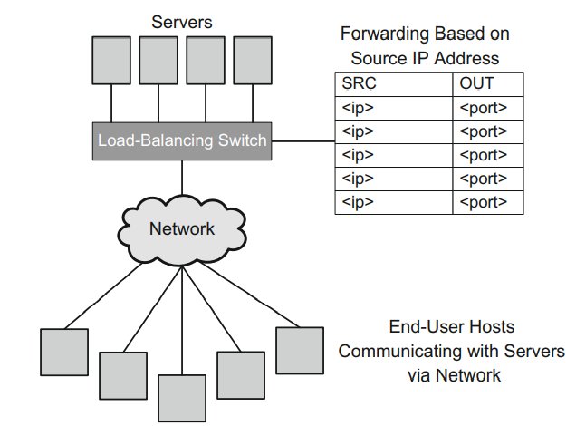
SDN Applied to Server Load Balancing

Slide 13
SDN Applied to Server Load Balancing
Load balancers must take incoming packets and forward them to the appropriate servers.
Using SDN and Open Flow technology, it is straightforward to imagine a switch or other networking device having rules in place that would cause it to act as a load-balancer appliance at a fraction of the cost of purchasing additional, specialized hardware.
Open Flow 1.0 supports matching against the basic 12-tuple of input fields.
A load balancer has a rich set of input options for determining how to forward traffic.
The forwarding decision could be based on the source IP address.
The fact that the controller will have the benefit of understanding the load on each of the links to the servers, as well as information about the load on the various servers behind the firewall, opens up other possibilities.
The controller could make load-balancing decisions based on a broader set of criteria than would be possible for a single network appliance.

Slide 14
SDN Applied to Firewalls
Firewalls take incoming packets and forward them, drop them, or take some other action such as forwarding the packet to another destination or to an IDS for further analysis.
Firewalls using SDN and OpenFlow have the ability to use any of the standard 12 match fields for making these forward or drop decisions.
Packets matching certain protocol types (e.g., HTTPS, HTTP, Microsoft Exchange) are forwarded to the destination, and those that do not match are dropped.
Simple firewalls that are ideally suited to an SDN-based solution include firewalls that are based on blocking or allowing specific IP addresses or specific TCP/UDP ports.
SDN-based firewalls may be limited by a lack of statefulness and inability for deeper packet inspection.
Insert an OpenFlow-enabled switch in front of a battery of firewalls.
SDN switch can load balance between the firewall devices, permitting greater scale of firewall processing, shunt known-safe traffic around the firewalls.
We offload from the firewalls traffic that is known to be problem-free. The benefit of doing so is that less firewall equipment and/or power is needed and less traffic is subjected to the latency imposed by firewall processing.

Slide 15
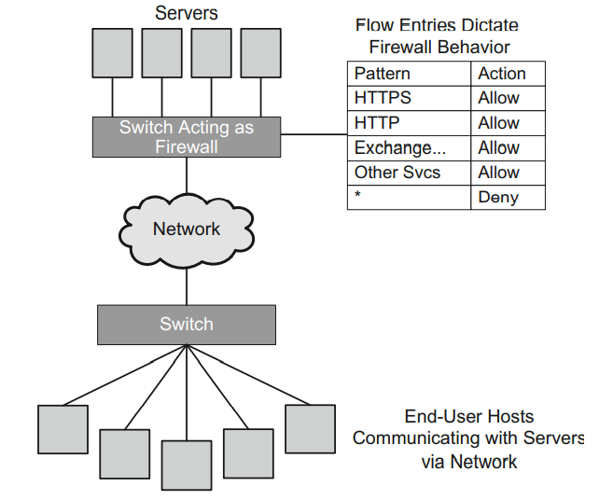
SDN Applied to Firewalls

Slide 16
SDN Applied to Intrusion Detection
An IDS is intended to observe network traffic to detect network intrusions. An IPS additionally attempts to prevent such intrusions.
IDS - deep inspection of packet payloads, searching for signs of viruses, trojans, worms, and other malware.
Since this inspection is processing-intensive, take place somewhere outside the data plane of the network.
Solution - utilize a network tap, which is configured to capture traffic from a particular source, such as a VLAN or physical port, and copy that traffic and forward it to an IDS for analysis. Physical taps such as this are mostly port-based.
OpenFlow is well suited to this application, since it is founded on the idea of creating flow entries that match certain criteria (e.g., device address, VLAN, ingress port) and performing some action.

Slide 17
SDN Applied to Intrusion Detection
A tap system using OpenFlow can be programmed to set up actions on the device to forward packets of interest either out through a monitor port or to the IP address of an IDS.
The FlowScale open source project done at InCNTRE is an example of this kind of front-end load balancing with the SPAN concept.
FlowScale sends mirrored traffic to a battery of IDS hosts, load balancing the traffic across them

Slide 18
Optical Networks
An optical transport network (OTN) is an interconnection of optical switches and optical fiber links.
The optical switches are layer one devices. They transmit bits using various encoding and multiplexing techniques.
The fact that such optical networks transmit data over a lightwave-based channel as opposed to treating each packet as an individually routeable entity lends itself naturally to the SDN concept of a flow.
In the past, data traffic was transported over optical fiber using protocols such as Synchronous Optical Networking (SONET) and Synchronous Digital Hierarchy (SDH).
More recently, however, OTN has become a replacement for those technologies.
Some companies involved with both OTN and SDN are Ciena, Cyan, and Infinera.
Some vendors are creating optical devices tailored for use in data centers.
Calient, for example, uses optical technology for fast links between racks of servers.

Slide 19
SDN Applied to Optical Networks
Elephant Flows
In data center networks, there often arise certain traffic flows that make intense use of network bandwidth, sometimes to the point of starving other traffic flows.
The flows are characterized by being of relatively long duration yet having a discrete beginning and end.
They may occur due to bulk data transfer, such as backups that happen between the same two endpoints at regular intervals.
These characteristics can make it possible to predict or schedule these flows.
Once detected, the goal is to reroute that traffic onto some type of equipment, such as an all-optical network that is provisioned specifically for such large data offloads.

Slide 20
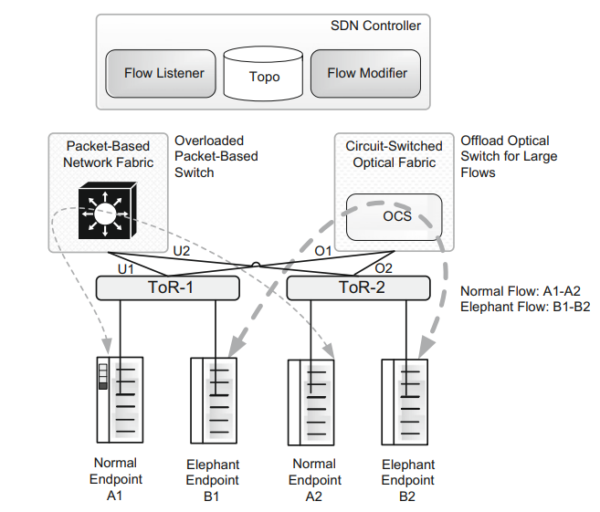
Effective mechanism for handling elephant flows

Slide 21
SDN Handling Elephant Flows
In Figure, we depict normal endpoints (A1, A2) connected through top-of-rack (ToR) switches ToR−1 and ToR−2, communicating through the normal path, which traverses the packet-based network fabric.
The other elephant devices (B1, B2) are transferring huge amounts of data from one to the other; hence, they have been shunted over to the optical circuit switch, thus protecting the bulk of the users from such a large consumer of bandwidth.
The mechanism for this shunting or offload entails the following steps
The elephant flow is detected between endpoints in the network.
Simply observing a sudden surge in the data flow between two endpoints in no way serves to predict the longevity of that flow.
If the flow is going to end in 500 ms, this is not an elephant flow and we would not want to incur any additional overhead to set up special processing for it.
Some additional contextual information is required to know that an elephant flow has begun. An obvious example is the case of a regularly scheduled backup that occurs across the network.

Slide 22
SDN Handling Elephant Flows
2. The information regarding the endpoints’ attaching network devices is noted, including the uplinks (U1, U2), which pass traffic from the endpoints up into the overloaded network core.
3. The SDN controller program flows in ToR−1 and ToR−2 to forward traffic to and from the endpoints (B1, B2) out an appropriate offload port (O1, O2) rather than the normal port (U1, U2). Those offload ports are connected to the optical offload fabric.
4. The SDN controller programs flows on the SDN-enabled optical offload fabric to patch traffic between B1 and B2 on the two offload links (O1, O2).
At this point, the rerouting is complete and the offload path has been established between the two endpoints through the OTN.
5. The elephant flow eventually returns to normal and the offload path is removed from both connecting network devices and from the optical offload device.
Subsequent packets from B1 to B2 traverse the packet-based network fabric

